Slide 1
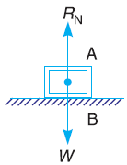
Theory of machines Wessam Al Azzawi
Friction:
Definitions
If a block is placed over a surface of the same or of different material, a certain degree of interlocking of the particles takes place. This does not involve any force if the block does not move or tends to move. But whenever the block moves or tends to move tangentially with respect to the surface, the interlocking of the particles opposes the motion. This opposing force, which acts in the opposite direction of the movement is called the force of friction or simply friction.
Every joint in a machine, force of friction arises due to the relative motion between two parts and hence some energy is wasted in overcoming the friction. Though the friction is considered undesirable, yet it plays an important role both in nature and in engineering e.g. walking on a road, motion of locomotive on rails, transmission of power by belts, gears etc.

Slide 2
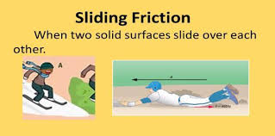
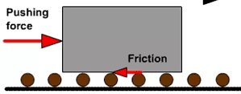
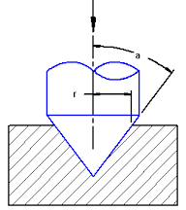
Theory of machines Wessam Al Azzawi
Friction:
Types of Friction
Static friction. It is the friction, experienced by a body, when at rest.
Dynamic friction. It is the friction, experienced by a body, when in motion. The dynamic friction is also called kinetic friction and is less than the static friction:
Sliding friction. It is the friction, experienced by a body, when it slides over another body.
Rolling friction. It is the friction, experienced between the surfaces which has balls or rollers interposed between them.
Pivot friction. It is the friction, experienced by a body, due to the rotation as in case of foot step bearings.

Slide 3
Theory of machines Wessam Al Azzawi
Friction:
Friction Between Unlubricated Surfaces
Is the friction experienced between two dry and unlubricated surfaces due to the surface roughness, it is also known as dry or solid friction.
limiting force of friction
Also know as limiting friction
0 ˂ static friction ˂ limiting friction

Slide 4
Theory of machines Wessam Al Azzawi
Friction:
Laws of Static Friction
Friction force is always opposite to that in which the body tends to move.
Friction force magnitude is exactly equal to the force, which tends the body to move.
The magnitude of the limiting friction (F ) bears a constant ratio to the normal reaction (R_{N}) between the two surfaces. Mathematically:
F/R_{N} = constant
Friction force is independent of the area of contact between the two surfaces.
The friction force depends upon the roughness of the surfaces.

Slide 5
Theory of machines Wessam Al Azzawi
Friction:
Laws of Dynamic Friction
Friction force is always opposite to the direction in which the body tends to move.
The magnitude of dynamic friction force bears a constant ratio to the normal reaction. It is slightly less than that in case of static friction.
For moderate speeds, the force of friction remains constant. But it decreases slightly with the increase of speed.

Slide 6
Theory of machines Wessam Al Azzawi
Friction:
Laws of Solid (dry) Friction
Friction is directly proportional to the normal load.
Friction is independent of the area of the contact surface.
Friction depends on the materials of the contact surfaces.
Laws of Fluid Friction
Friction is independent of the load.
Friction reduces with the increase of the temperature.
Friction is independent of the substances of the surfaces.
Friction is different for different lubricants.

Slide 7
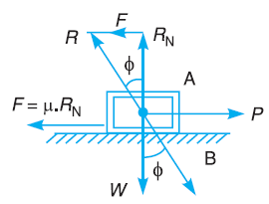
Theory of machines Wessam Al Azzawi
Friction:
Limiting Angle of Friction
The magnitude of the friction is F = μ.W = μ.R_{N}
R_{N} is the normal reaction.
When the motion just begins, the body will be in equilibrium under the action of:
Weight (W)
Horizontal force (P)
Reaction (R)
Reaction R must be equal and opposite to the resultant of W and P.
R inclined at an angle φ to the normal reaction RN. (φ is known as the limiting angle of friction).
tan φ = F/R_{N} = μ R_{N} / R_{N} = μ

Slide 8
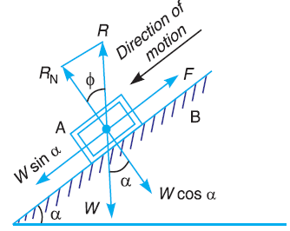
Theory of machines Wessam Al Azzawi
Friction:
Angle of repose
If the angle α is such that the body begins to move down the plane, then the angle α is called the angle of repose.
the body will move down the plane when the angle of inclination is equal to the angle of friction (i.e. α = φ).
W sin α, tends to slide the body down.
W cos α, perpendicular to the plane and balanced by the normal reaction (R_{N}).
∴ The body will move when:
W sin α = F = μ.R_{N} = μ.W cos α
tan α = μ = tan φ or α = φ

Slide 9
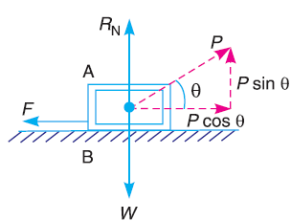
Theory of machines Wessam Al Azzawi
Friction:
Minimum Force Required to Slide a Body
For the equilibrium of the body A:
R_{N} + P sin θ = W ……..(1)
R_{N} = W – P sin θ ……..(2)
P cos θ = F = μ.R_{N}
Substituting the value of R_{N} from equation (1),
P cos θ = μ (W – P sin θ) = tan φ (W – P sin θ) ∵ μ = tan φ
P cos θ .cos φ = W sin φ – P sin θ.sin φ
P cos θ.cos φ + P sin θ.sin φ = W sin φ (∵cos θ. cos φ + sin θ.sin φ = cos (θ – φ))
For P to be minimum, cos (θ – φ) should be maximum
cos (θ – φ) = 1 or θ – φ = 0° or θ = φ P_{min} = W sin θ
(x cos φ)

Slide 10
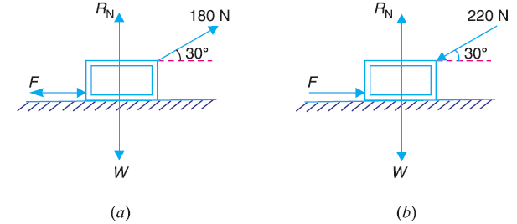
Theory of machines Wessam Al Azzawi
Friction:
Example .1. A body, resting on a rough horizontal plane required a pull of 180 N inclined at 30º to the plane just to move it. It was found that a push of 220 N inclined at 30º to the plane just moved the body. Determine the weight of the body and the coefficient of friction.
Slo. (a)
F = 180 cos 30º = 180 × 0.866 = 156 N
R_{N} = W – 180 sin 30º = W – 180 × 0.5 = (W – 90) N
F = μ.R_{N} or 156 = μ (W – 90) ……(1)
(b)
F = 220 cos 30º = 220 × 0.866 = 190.5 N
R_{N} = W + 220 sin 30º = W + 220 × 0.5 = (W + 110) N
F = μ.R_{N} or 190.5 = μ (W + 110) …….(2)
From (1) and (2)
W = 1000 N, and μ = 0.1714 Ans.

Slide 11
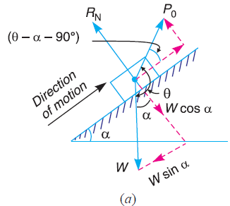
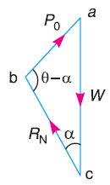
Theory of machines Wessam Al Azzawi
Friction:
Friction of a Body on a Rough Inclined Plane
Motion up the plane
If friction is neglected, the body is in equilibrium under the three forces, i.e. P₀, W and RN Fig. (a).
The triangle of forces is shown in Fig.(b).
Sin rule
W = Weight
α = Angle of the plane
φ = Limiting angle of the surfaces,
P = Force applied to slide the body, considering friction.
P₀ = Force required to move the body up the plane neglecting friction.
.
θ = Angle between P and W
μ = Coefficient of friction
R_{N} = Normal reaction
R = Resultant reaction

Slide 12
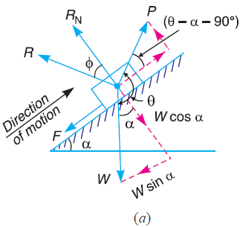
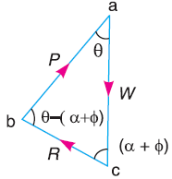
Theory of machines Wessam Al Azzawi
Friction:
Friction of a Body on a Rough Inclined Plane
If friction is taken into account, a frictional force F = μ.R_{N} Fig.(a)
The triangle of forces is shown in Fig.(b).
Sin rule
When the applied force is horizontal, then θ = 90º

Slide 13
Theory of machines Wessam Al Azzawi
Friction:
Friction of a Body on a Rough Inclined Plane
When the applied force is horizontal, then θ = 90º
When the applied force is parallel to the plan, then θ = 90º+ α
P = W (sin α + μ cos α)

Slide 14
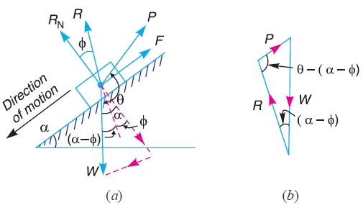
Theory of machines Wessam Al Azzawi
Friction:
Friction of a Body on a Rough Inclined Plane
motion of the body down the plane
If friction is neglected he force required for the motion down the plane will be same as for the motion up the plane

Slide 15
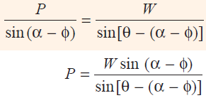
Theory of machines Wessam Al Azzawi
Friction:
Friction of a Body on a Rough Inclined Plane
When the friction is taken into account, the friction F = μ.R_{N} will act up the plane and the resultant R will make an angle φ with R_{N} as shown in Fig. (a). From sine rule:

Slide 16
Theory of machines Wessam Al Azzawi
Friction:
Friction of a Body on a Rough Inclined Plane
When P is horizontal, then θ = 90º
When the applied force is parallel to the plan, then θ = 90º+ α
P = W (sin α – μ cos α), (tan φ = μ)

Slide 17
Theory of machines Wessam Al Azzawi
Friction:
Efficiency of Inclined Plane
The ratio of the force required neglecting friction (i.e. P₀) to the force required considering the friction (i.e. P) is known as efficiency of the inclined plane.
η = P₀ / P
Motion of the body up the plane

Slide 18
Theory of machines Wessam Al Azzawi
Friction:

Slide 19
Theory of machines Wessam Al Azzawi
Friction:
Motion of the body up the plane

Slide 20
Theory of machines Wessam Al Azzawi
Friction:

Slide 21
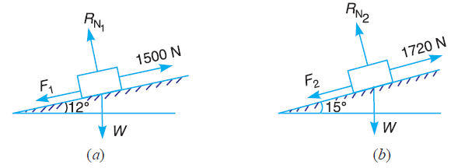
Theory of machines Wessam Al Azzawi
Friction:
Example. An effort of 1500 N is required to just move a certain body up an inclined plane of angle 12º, force acting parallel to the plane. If the angle of inclination is increased to 15º, then the effort required is 1720 N. Find the weight of the body and the coefficient of friction.
Solution. Given : P1 = 1500 N ; α₁ = 12º ; α2 = 15º ; P2 = 1720 N
For motion up the plane, the force applied parallel to the plane
P₁= 1500 = W (sin α₁ + μ cos α₁)
= W (sin 12º + μ cos 12º) ………..(1)
For motion down the plane, the force applied parallel to the plane
P₁= 1720 = W (sin α₂ + μ cos α₂)
= W (sin 15º + μ cos 15º) ………..(2)
Dividing equation (2) by equation (1) μ =0.131 Ans.
Substitute in (1) W = 4464 N Ans

